Slide 1
Personality Testing
Notes:
Add slide notes here

Slide 2
Defining Personality
Personality = set of enduring, consistent characteristics within an individual
Characteristic patterns of thoughts, feelings, and behaviors that make each person unique

Slide 3
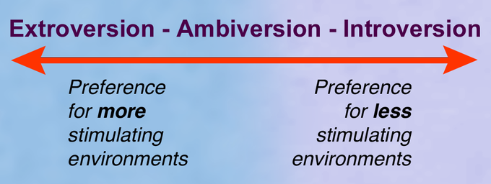
Trait Perspectives of Personality
Trait
  Enduring disposition that leads to characteristic responses
  The traits one possesses are how we define “personality” – Trait Theories
Traits operate on a continuum:

Slide 4
History of Trait Approaches (1)
Gordon Allport (1897 – 1967)
  Behavior tends to be consistent across situations
  These consistencies can be defined as “traits”
    4505 words in the English language that could be used to describe traits
Raymond Cattell: Cut the list back to ~170 traits, which combined into 60 personality “clusters”
Later work reduced this to 35 traits (added an IQ measure as a 36th trait)

Slide 5
History of Trait Approaches (2)
Tupes & Christal (1957): Pioneered a five-factor model
  Surgency, Agreeableness, Dependability, Emotional Stability, and Culture
Peter Seville (1978): Updated model -- Anxiety, Imagination, Warmth, Extraversion, and Conscientiousness
Digman et al. (1980): Friendly vs. Hostile Compliance, Extraversion vs. Introversion, Ego strength vs Emotional Disorganization, Will to Achieve, and Intellect
Notes:
“surgency” tendency toward positive mood
“ego strength” == social appropriateness

Slide 6
History of Trait Approaches (3)
Costa & McCrae (1987) – “Big 5” Traits
  Very commonly used approach to personality
  Traits are independent*
  1.) Neuroticism
  2.) Extroversion
  3.) Openness to Experience
  4.) Agreeableness
  5.) Conscientiousness

Slide 7
Neuroticism
6 Facets:
  Anxiety, hostility, self-consciousness, depression, impulsiveness, and vulnerability
    High in neuroticism typically means high in all areas
  Anxiety/hostility are the basis for fear and anger
  Self-consciousness/depression relate to shame
  Impulsiveness/vulnerability manifest as behaviors

Slide 8
Extroversion
3 interpersonal traits
  Warmth, gregariousness (enjoyment of being with others), and assertiveness
3 temperamental traits
  Activity, excitement seeking, and positive emotions
High in extroversion typically results in:
  Keeping busy, preferring stimulating environments
  Preference for social situations and occupations

Slide 9
Openness to Experience
6 facets
  1.) Fantasy: Vivid imagination and active dream life
  2.) Aesthetics: Appreciation of art and beauty
  3.) Action: Willingness to try something new
  4.) Ideas and Values: Curious and value knowledge for the sake of knowing
  5.) Open-mindedness: Acceptance of difference
  6.) Willingness to think of different possibilities: Avoiding functional fixedness, creativity

Slide 10
Agreeableness
Opposite of antagonism
If low
  Tendency to set themselves against others
  Skeptical
  Mistrustful
  Callous
  Unsympathetic
  Stubborn
  Rude
Scoring high is not necessarily good

Slide 11
Conscientiousness
Includes traits such as:
  Hardworking
  Ambitious
  Energetic
  Persevering
  Punctual
Positively correlated with
  Cognitive abilities: Working memory and attentional control

Slide 12
The Big Five Personality Dimensions
Dimension | Basic Definition | Key Characteristics
Openness to experience | Curiosity and interest in variety vs. preference for sameness | Openness to fantasy, esthetics, feelings, actions, ideas, values
Conscientiousness | Discipline and organization vs. lack of seriousness | Competence, order, dutifulness, striving for achievement, self-discipline, deliberation
Extraversion | Sociability and outgoingness vs. introversion | Warmth, gregariousness, assertiveness, activity, excitement seeking, positive emotions
Agreeableness | Compliance and cooperativeness vs. suspiciousness | Trust, straightforwardness, altruism, compliance, modesty, tender-mindedness
Neuroticism | Emotional instability vs. stability | Anxiety, hostility, depression, self-consciousness, impulsiveness, vulnerability
Notes:
Table 11.1 The Big Five Personality Dimensions

Slide 13
Are Personality Traits Stable Over tTme?
Argue that personality traits no longer change after age 30
Research shows that these 5 dimensions can be relatively stable over time (30+ years) and across age groups (20-90 years of age)

Slide 14
Is the Big-5 Cross-Cultural?
These personality traits appear to occur cross-culturally
  What differs is the extremes on the continuum
  E.g., Eastern cultures do not typically show as many high extraversion people
Some evidence that personality factors show up in animals
  Dogs: Outgoingness (extraversion/openness)

Slide 15
Are Big-Five Traits Actually Independent?
No
Extraversion is positively correlated with openness and agreeableness
Conscientiousness and Neuroticism are negatively correlated

Slide 16
Many other different types of traits…
HEXACO Model (Ashton & Lee, 2018)
  Adds honesty/humility to the Big-5
“Dark Triad” of personality

Slide 17
The “Dark Triad” of Personality
Not all personality characteristics are advantageous
  Socially undesirable, malevolent qualities
Machiavellianism
  Manipulation/exploitation of others without morality
Psychopathy
  Antisocial behavior including impulsivity and lack of emotion
Narcissism
  Lack of empathy for others, self-focus, prideful, egotistical

Slide 18
Evaluating Trait Perspectives
Contributions
  Traits appear to be somewhat independent
  Everyone is on a continuum
  Traits are easy to describe and communicate to others
  Traits related to behavioral effects (career choices, probability of getting married, having kids, etc.)
Criticisms
  Somewhat independent ≠ independent
  Emphasis is not on the situation the behavior occurs in
  Other traits may be available that are not actually measured
    E.g., Honesty/Humility (Ashton & Lee, 2008)

Slide 19
Life Story Perspectives
Hypothetical: If you have 2 people with the exact same traits, would they be the same person?
Personology (Henry Murray) – The study of one’s life history or life story
  Psychobiography: One’s psychological history and its relationship to personality

Slide 20
Personality Trait Assessments
How does one measure these characteristics?
  Allport: 4,500 words
Self-report tests
  Ask subjects whether specific descriptions are accurate of themselves
  MMPI-2: Minnesota Multiphasic Personality Inventory, 567 Items
  NEO-AC Inventory: 100 Items; 60 Shortened version

Slide 21
Non-Trait Personality Assessments
Projective Tests
  Ambiguous stimulus, test taker projects what they think the meaning is
  Rorschach Inkbot Test

Slide 22

Rorschach Test

Slide 23
Personality Assessments
Thematic Apperception Test (TAT)
  Reveals an individual’s perception of interpersonal relationships
  Individuals view a scene and are asked to tell a dramatic story including:
    What has led up to the event?
    What is currently happening?
    What are the thoughts and feelings of the characters?
    What is the outcome?

Slide 24
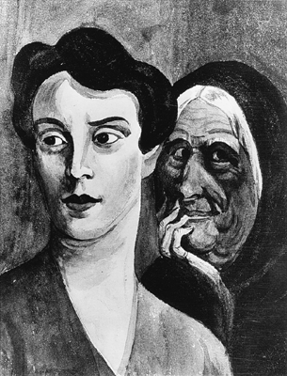
Thematic Apperception Test (TAT)

